Slide 1
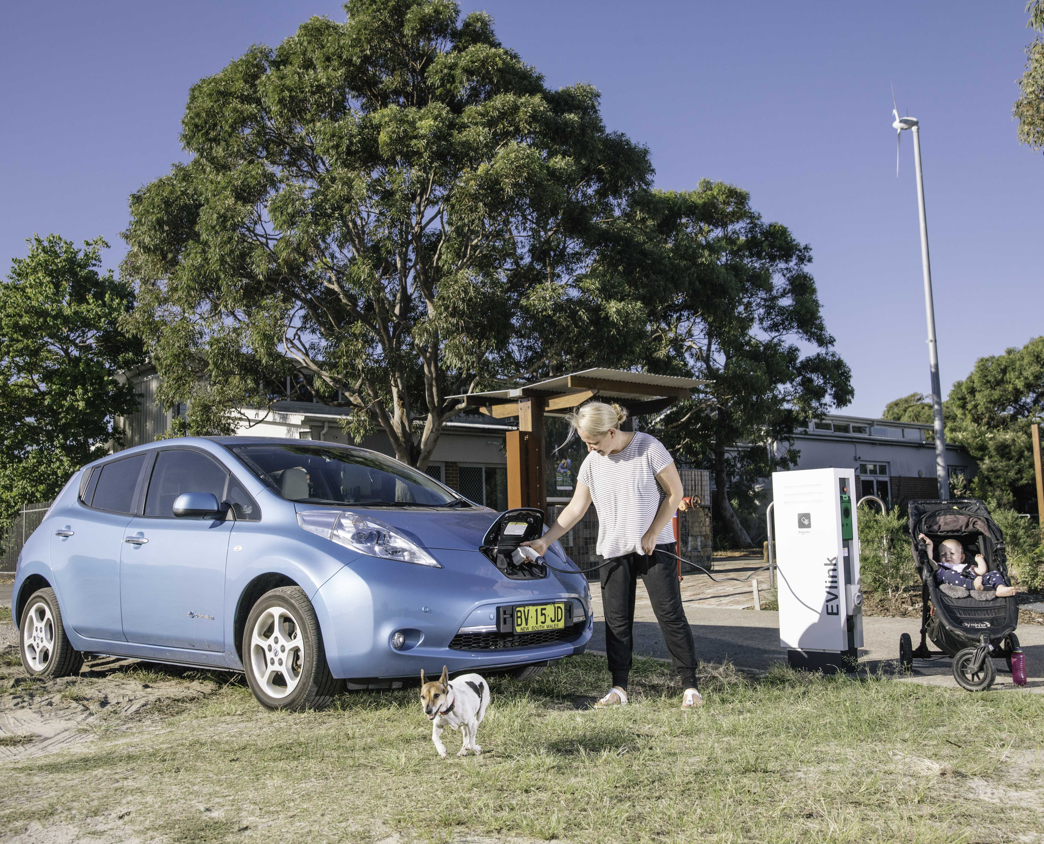
Electric Vehicles & Charging Stations

Slide 2
Timing:
Intro: 5 mins
EVs: 15 mins
Charging: 15 mins
Case Study: 10 mins
Questions: 15 mins

Slide 3
Content
Electric Vehicles
Charging Stations
Case Study
Council Programs
Questions
Notes:
1 Emissions per Person (2019/20)

Slide 4
Electric Vehicles

Slide 5
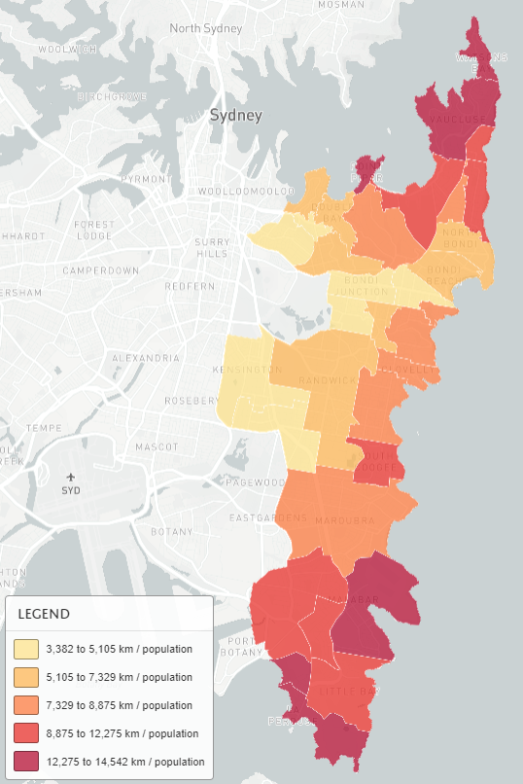
Why Electric Vehicles?
Eastern Suburbs Emissions by Source
(2019/20)
Eastern Suburbs Travel by Suburb
(2019/20)
Gas
9%
Waste
18%
Electricity
55%
Transport
20%
Notes:
A typical electric vehicle charged using the average Australian electricity grid mix generated about 40% fewer emissions. Improve by 33 per cent over the period 2020 to 2030 (Wheel to Well, i.e. all)

Slide 6
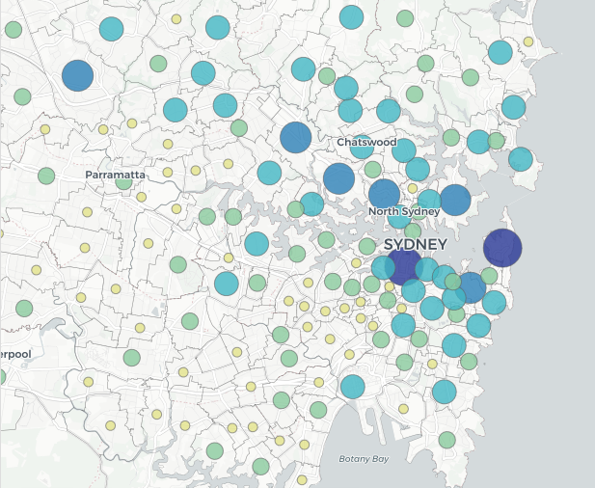
Why Electric Vehicles?
Electric Vehicle Ownership by Suburb
(2020)
Notes:
A typical electric vehicle charged using the average Australian electricity grid mix generated about 40% fewer emissions. Improve by 33 per cent over the period 2020 to 2030 (Wheel to Well, i.e. all)

Slide 7
Eastern Suburbs EV Survey
1,186 respondents
79% are considering purchasing an EV when they buy their next car
86% wanted Council to facilitate more EV charging
79% said the increased availability in public EV charging stations in the eastern suburbs would influence their decision to purchase an EV
43% don't have access to a garage, carport or parking space where there is a power point or electrical connection nearby

Slide 8
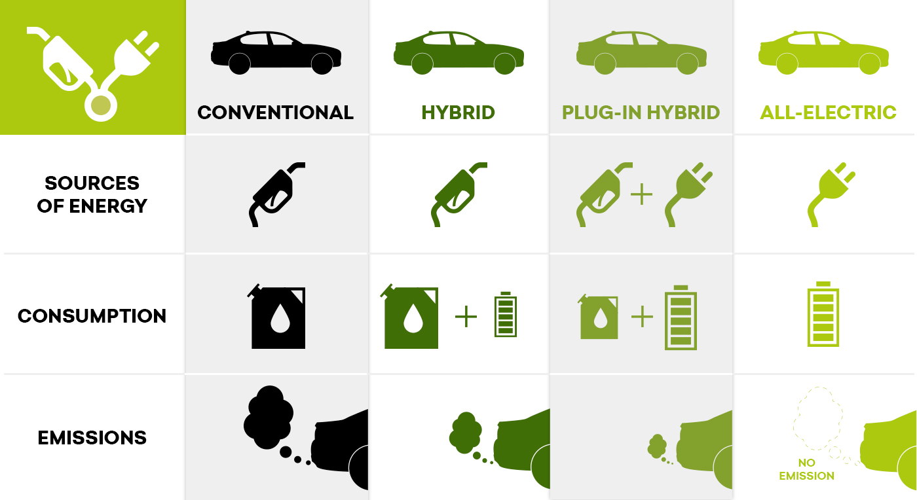
Types
Notes:
Set the scene.
4 main types of cars.
Convectional = petrol/diesel – internal combustion engine
Hybrid =battery and petrol/diesel – internal combustion engine and a large battery which charges when you break. Extends range.
Plug in hybrid = fill up at the pum and also charge with an an electric plug. Electric for city, petrol for long range.
All electric (commonly referred to as EVs)
Focus today an electric plug and no tailpipe emissions
Hydrogen Fuel Cells (combine Hydrogen + Oxygen to make electricity) more likely for heavier vehicles.

Slide 9
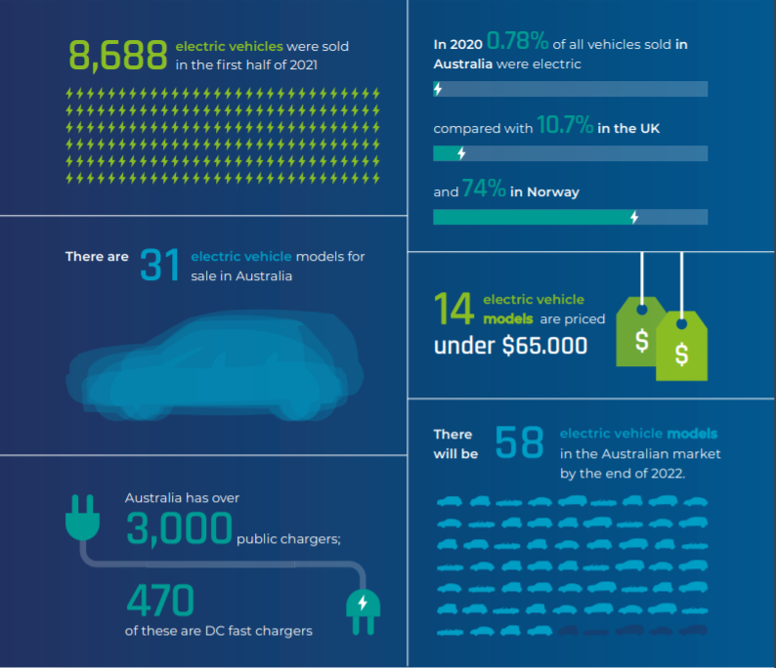
Market Update
Notes:
31 EVs currently (14 under $65k).
By end of next year 58 EVs on market.
More EV sales in the first half of 2021 than whole of 2020
https://electricvehiclecouncil.com.au/wp-content/uploads/2021/08/EVC-State-of-EVs-2021-3.pdf

Slide 10
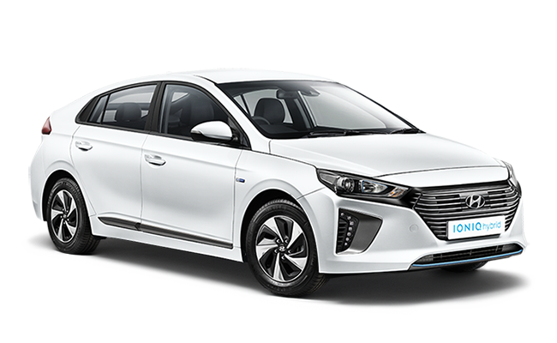
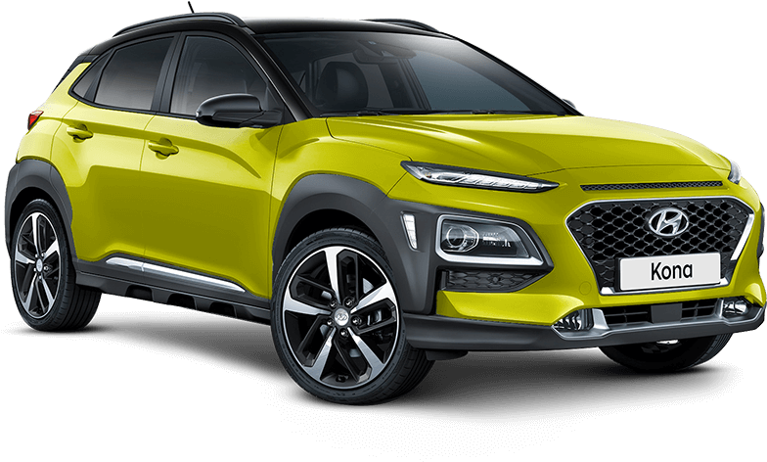
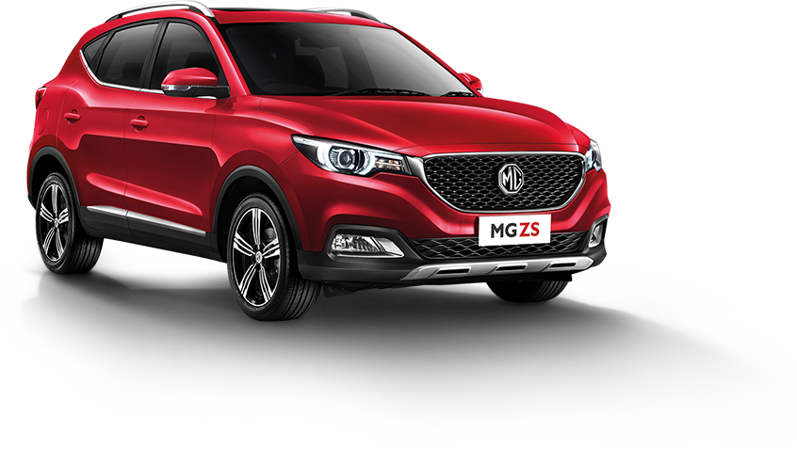
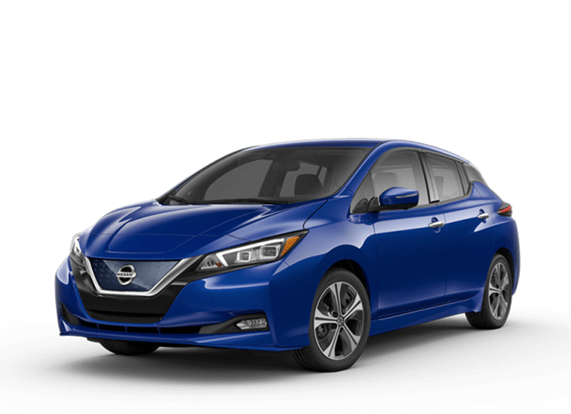
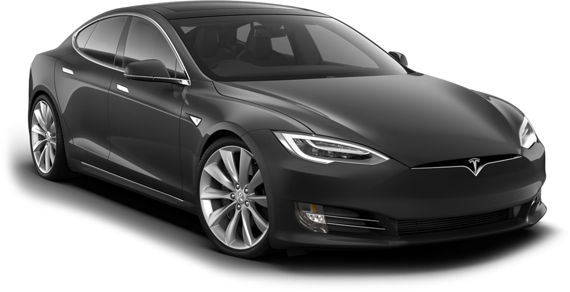
Models & Prices
Prices and Ranges
(excludes on-road costs and government subsidies)
Hyundai Ioniq: $48,390 / 311 km
Hyundai Kona: $60,140 / 449 km
MG ZS: $40,990 / 263 km
Nissan Leaf: $49,990 / 270 km
Tesla Model 3: $60,000 / 490 km
Notes:
31 EVs currently. By end of next year 58 EVs on market.
Cost parity with traditional Internal Combustion Engines by no later than 2025
Average daily distance travelled in Sydney is 38 km.
https://www.carsguide.com.au/urban/hacks/12-best-evs-available-in-australia-78872

Slide 11
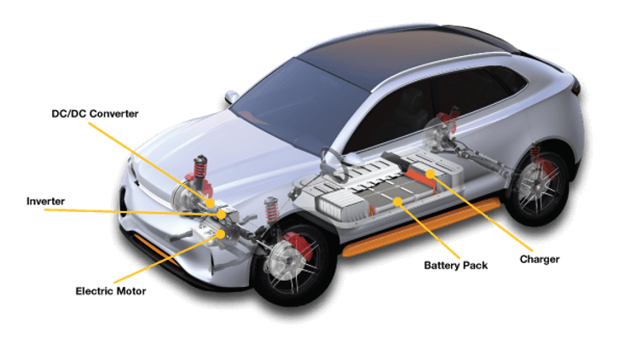
What makes EVs different?
Simpler
Quieter
Single gear
Regenerative breaking
Cheaper to run
Instantaneous torque –more fun to drive!
Less maintenance costs
Car learns as it goes –(Tesla only)
Safety –design features
CO2emissions comparison
Less pollution (particulate matter)
Notes:
31 EVs currently. By end of next year 58 EVs on market.
Cost parity with traditional Internal Combustion Engines by no later than 2025
Average daily distance travelled in Sydney is 38 km.
https://www.carsguide.com.au/urban/hacks/12-best-evs-available-in-australia-78872

Slide 12
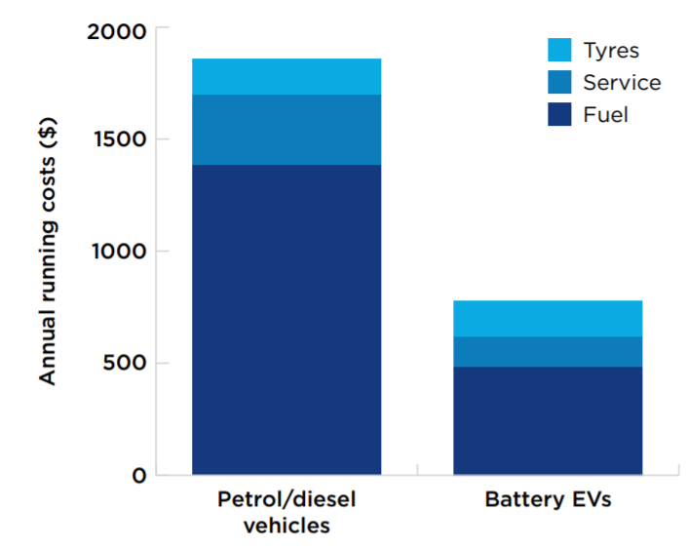
Running Costs
Approximately half the running cost for a small/medium passenger car due to:
Fuel is 70% cheaper
Regenerative breaking
Low maintenance and less fluids (20 moving parts vs 2,000)
Approx. half running cost
Notes:
BEV – maintenance items
Battery test
Electric motor test
Invertor check
ICEV – regular maintenance items
Oil
Transmission
Ignition system
Fuel filter
Timing belt
Engine air filter
Engine maintenance
Graph: NSW Strategy – saving of around $1,000 per year.
https://www.whichcar.com.au/car-advice/how-much-does-it-cost-to-charge-an-electric-car

Slide 13
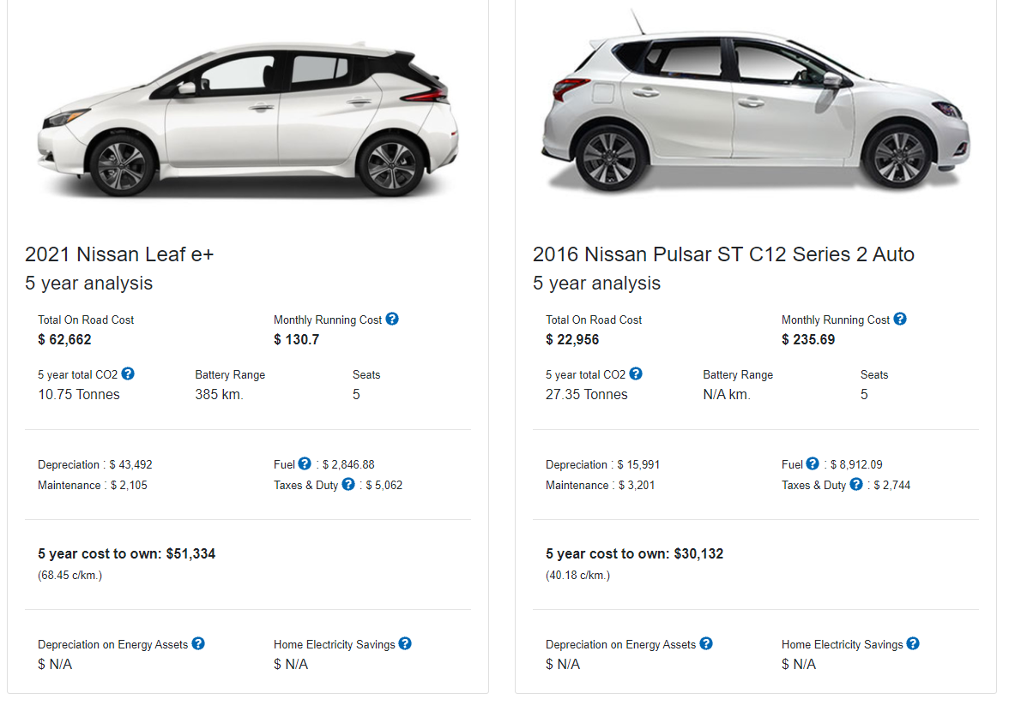
Paybacks
https://www.transport.nsw.gov.au/projects/electric-vehicles/total-cost-of-ownership
Approx. half running cost
Notes:
BEV – maintenance items
Battery test
Electric motor test
Invertor check
ICEV – regular maintenance items
Oil
Transmission
Ignition system
Fuel filter
Timing belt
Engine air filter
Engine maintenance
Graph: NSW Strategy – saving of around $1,000 per year.
https://www.whichcar.com.au/car-advice/how-much-does-it-cost-to-charge-an-electric-car

Slide 14
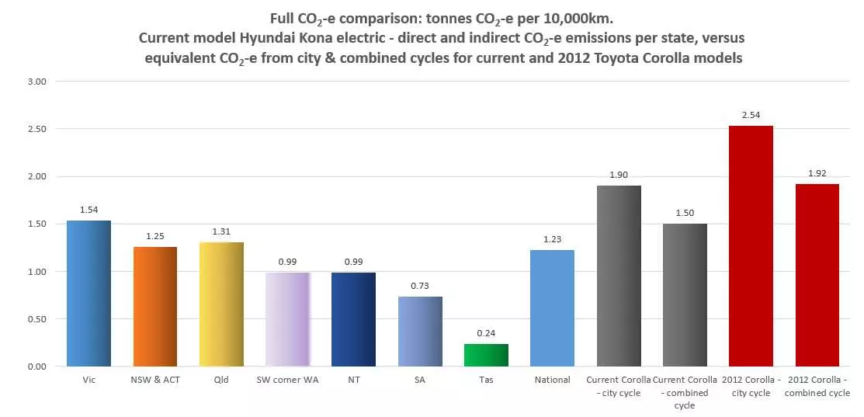
Emissions
https://thedriven.io/2021/06/16/explainer-emissions-from-electric-vehicles-are-lower-than-petrol-cars-in-australia/
Approx. half running cost
Notes:
BEV – maintenance items
Battery test
Electric motor test
Invertor check
ICEV – regular maintenance items
Oil
Transmission
Ignition system
Fuel filter
Timing belt
Engine air filter
Engine maintenance
Graph: NSW Strategy – saving of around $1,000 per year.
https://www.whichcar.com.au/car-advice/how-much-does-it-cost-to-charge-an-electric-car

Slide 15
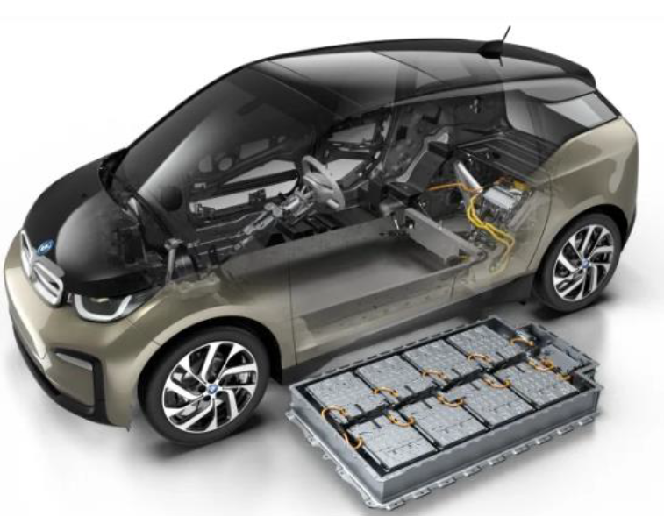
Batteries lifecycle and recycling
Currently made from lithium-ion (like mobile phones).
Manufacturers like Nissan now expect EV batteries will outlast vehicles by 10-12 years.
Current Tesla batteries degrade around 8-10% after driving 260,000kms (unusable after 70-80% degradation).
Typically 8-10 years warranty.
Notes:
https://fleets.chargetogether.org/article/mythbusting/

Slide 16
Industry Targets
Phasing out internal combustion engines in Europe by 2030
Only selling EVs in Europe by the end of 2022
15 new EV models by 2025
A fully electric car company by 2030
Notes:
https://www.environment.nsw.gov.au/-/media/OEH/Corporate-Site/Documents/Climate-change/nsw-electric-vehicle-strategy-210225.pdf

Slide 17
NSW Electric Vehicle Strategy (Sept. 2021)
$3000 rebate on first 25,000 EVs (under $70k) sold in NSW.
No stamp duty for EVs under $78k. All other EVs and plug-in hybrids no stamp duty from 2027 (or when EVs make up 30% of sales).
Road user charge from 2027 (or when EVs make up 30% of sales).
Use of car pool lanes and priority parking spaces
Investing in EV Super Highways and Commuter Corridors in NSW
Increase EV sales to 52% by 2030–31
Notes:
https://www.environment.nsw.gov.au/-/media/OEH/Corporate-Site/Documents/Climate-change/nsw-electric-vehicle-strategy-210225.pdf

Slide 18
Charging Stations

Slide 19
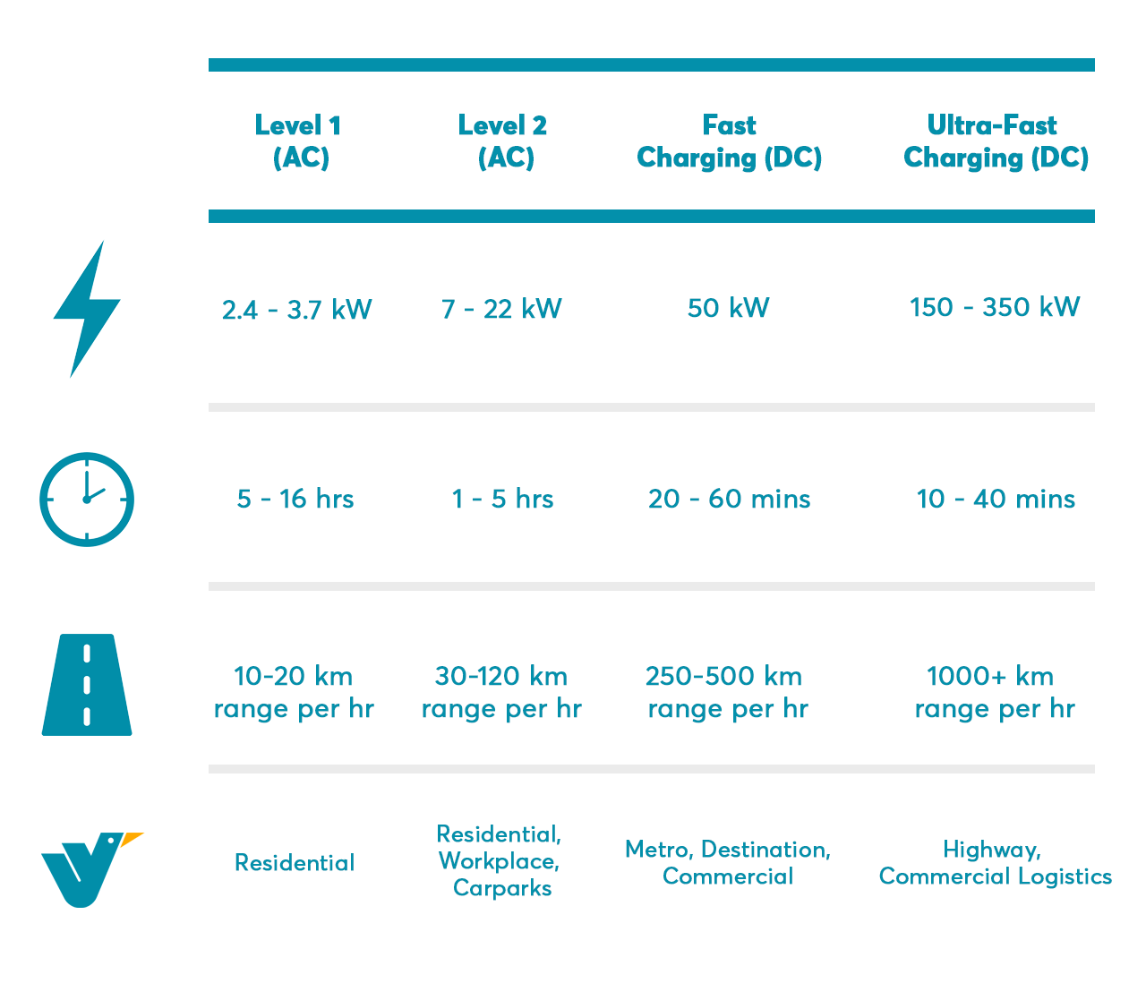
Charging Types
Council’s public EV charging network
80% of charging is done from home!
Notes:
The average Australian drives 38 km per day
Plug: the Mennekes plug (i.e. Type 2 plug) is now the standard for all electric vehicles in Australia.
What do you think is the average daily driving distance in Sydney?
Less than 38km per day
Current range of EVs (listed vs real world)
Tesla Model S – 660km
Kia Niro – 455km
Hyundai Kona – 449km
Nissan Leaf – 270km
Hyundai Ioniq – 230km
Types of chargers available
Refer to table on slide (ChargeFox data)
Level 1
Existing power point (10-15 Amp, single phase), used in combination with a specialised cable which is typically supplied with the vehicle.
Typically used in domestic houses, this method will add between 10 and 20km of range per hour plugged in.
It will top up daily use, but will not fully recharge a typical pure electric vehicle overnight.
Level 2
A dedicated AC EV charger at up to 7kW (32 Amp, single phase).
Typically installed in homes, apartment complexes, workplaces, shopping centres, hotels, etc – anywhere the vehicle will be parked for a while.
This method will add up to 40km of range per hour plugged in.
It will top up average daily vehicle use in an hour, or deliver a full recharge overnight.
Level 3
A dedicated DC EV charger at power levels from 25kW to 350kW (40 – 500 Amp, three phase)
Typically used in commercial premises and road-side locations to provide for faster recharging than Level 1 and 2 can achieve.
At the lower end, this method will add up to 150km of range per hour plugged in
At the upper end, this method can fully recharge some electric vehicles in 10 to 15 minutes.
Considerations
Where to put chargers
How to arrange payment
Unit blocks or terraces with no driveway
Public Charging Station Locations
Various companies and government organisations supporting rollout of fast charging stations eg NRMA
Various Apps exist that can be put onto phones – ChargeFox - Show an example
Electric Vehicle Council has an online map – Show example

Slide 20
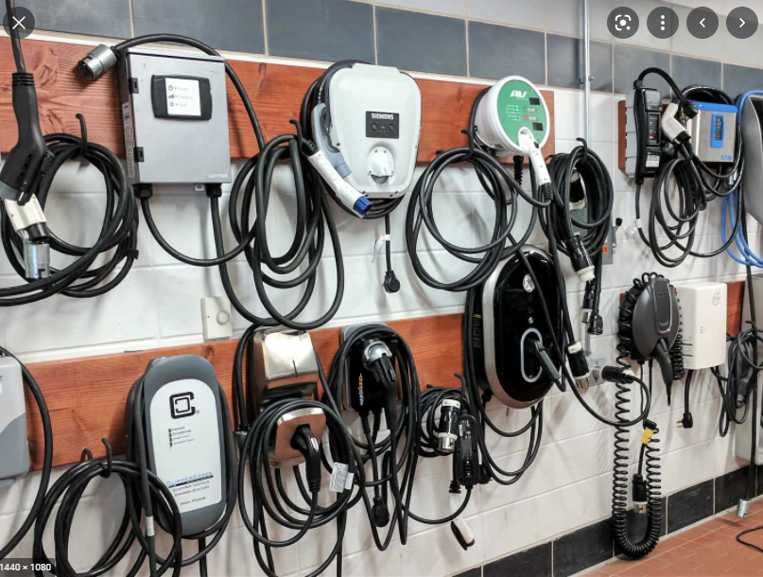
Charging Types
Level 1 7kW AC
Level 2 7-22kW AC
Notes:
Barnawartha truckstop, VIC,

Slide 21
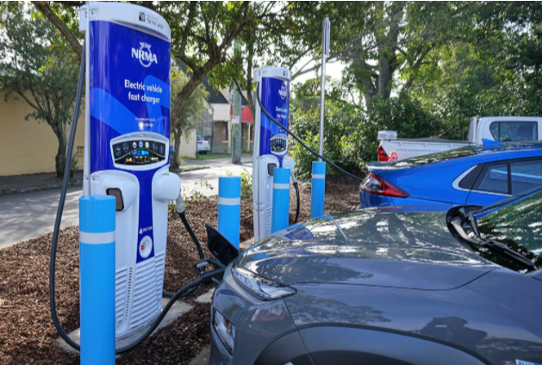
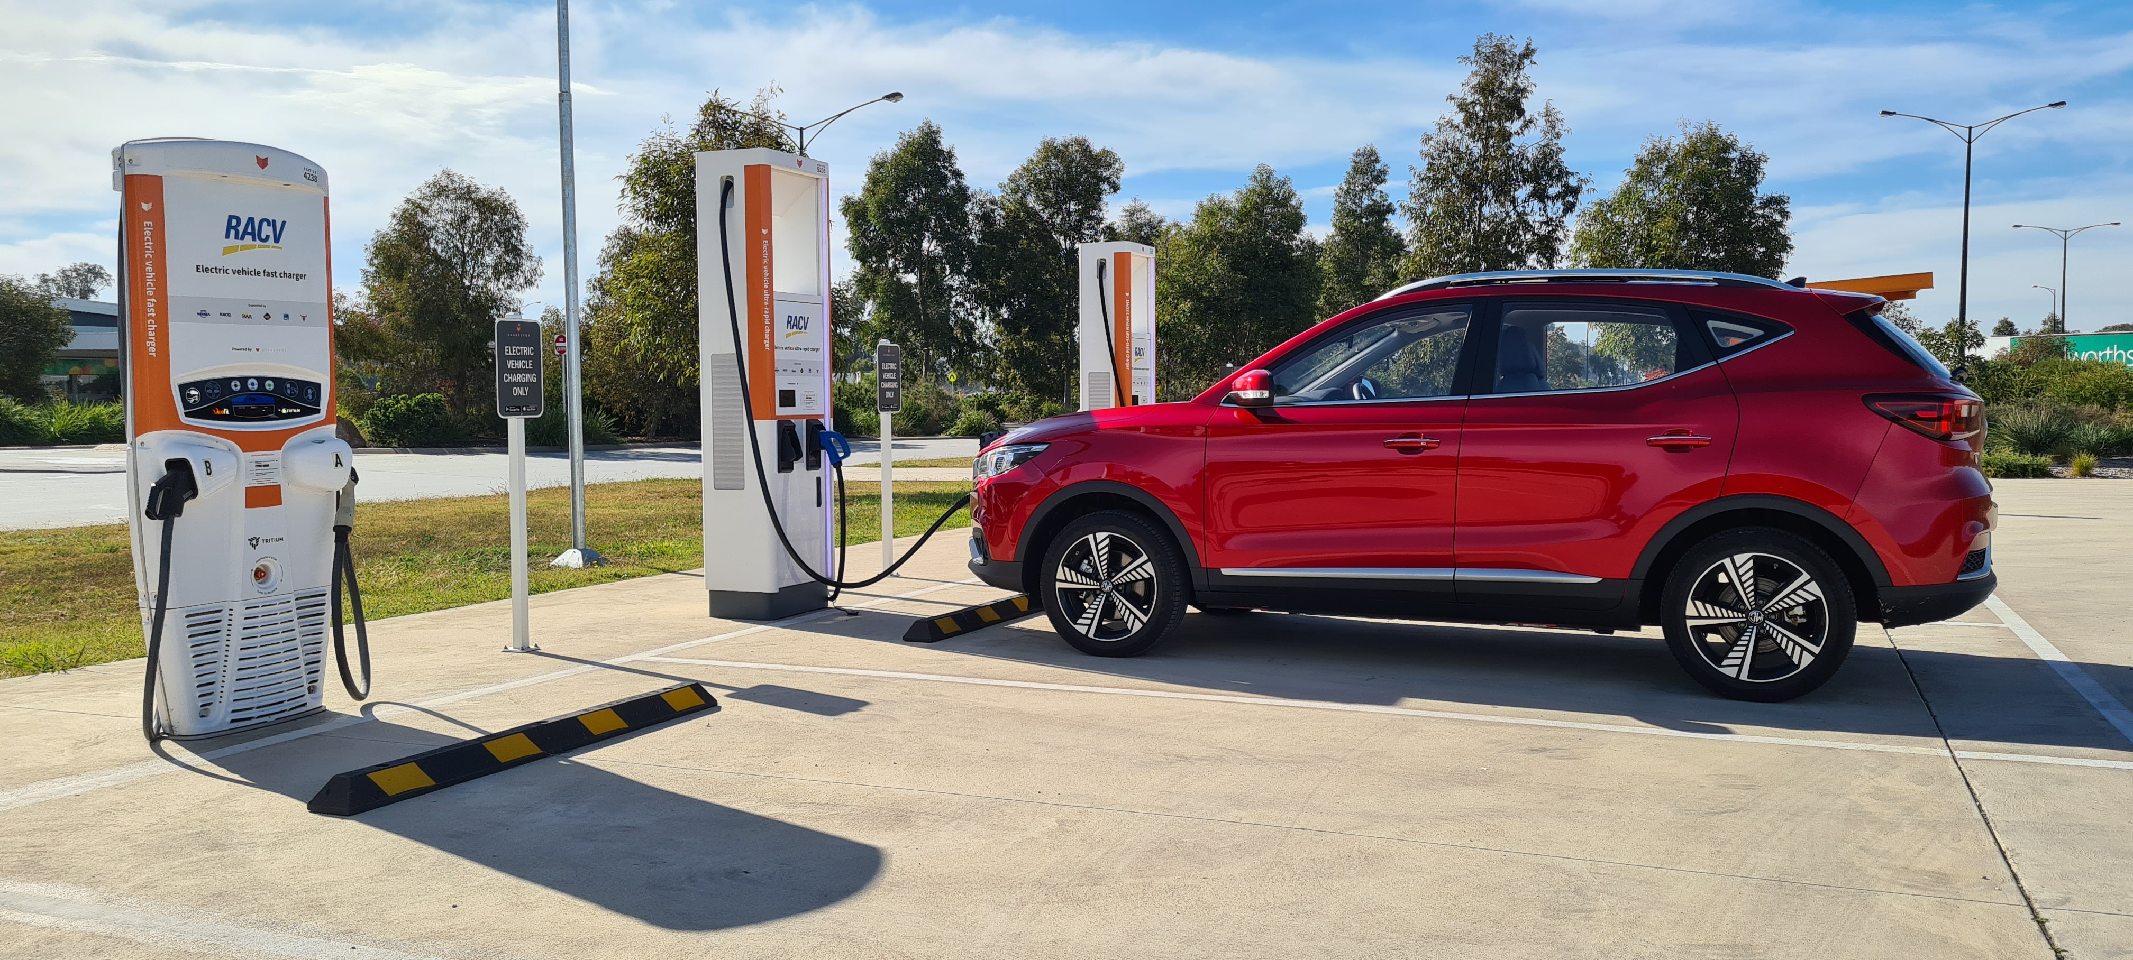
Charging Types
Fast Charging 50kW DC
Ultra-Fast Charging 350kW DC
Notes:
Barnawartha truckstop, VIC,

Slide 22
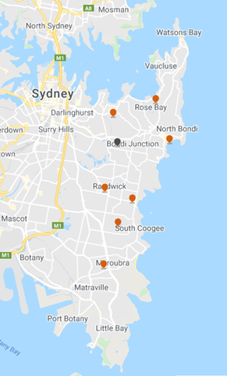
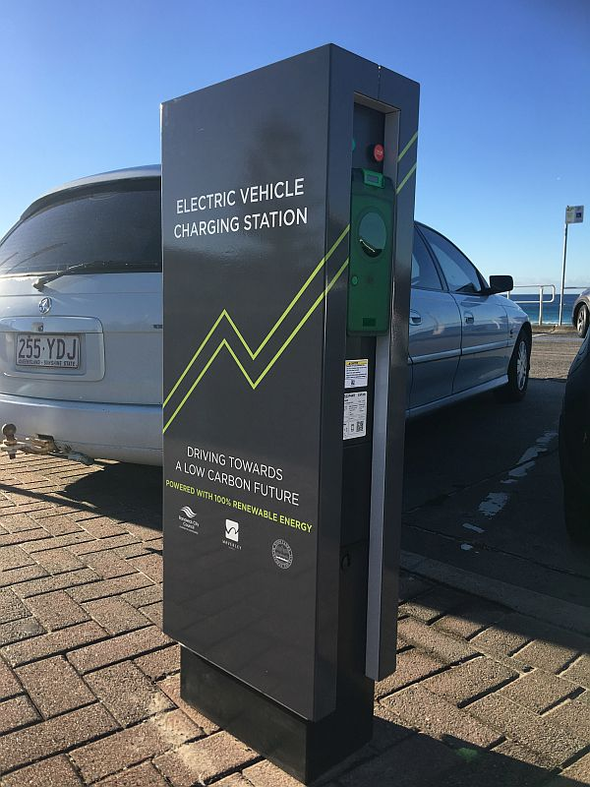
Eastern Suburbs EV Charging Network
8 charging stations Level 2
Approx. $10 / 2 hrs for 300 km
BYO charging cables
Usage grew 400% in FY21 (2,500 charging sessions)
Notes:
300 km is a Nissan Leaf
Charges up to 150km/hour
Exponential growth. In 2020-21 there were 2,482 charging sessions across the network which equated to an increase of 380% on the previous financial year.
Target of 5 new publicly accessible electric vehicle charging stations per year until 2031.

Slide 23
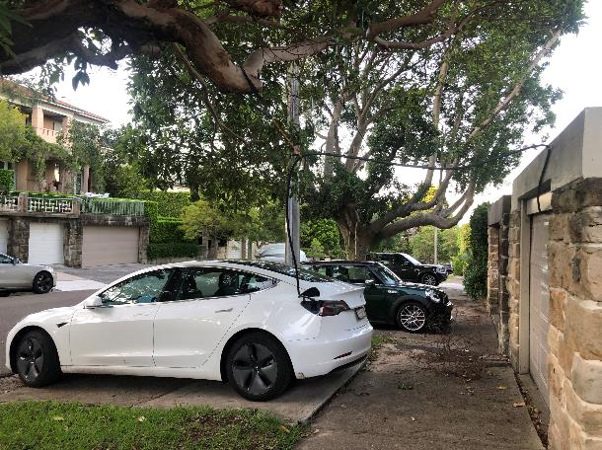
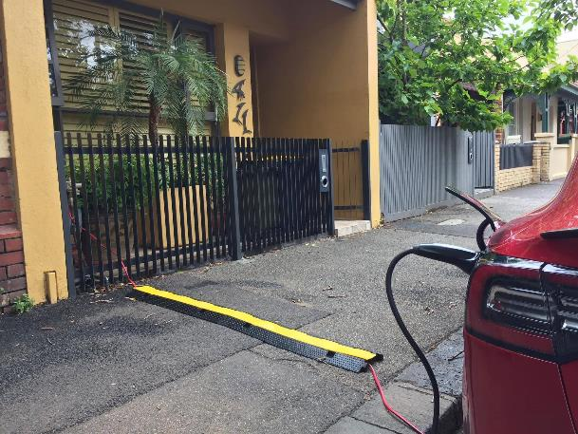
Charging Problems and Barriers
Notes:
300 km is a Nissan Leaf
Charges up to 150km/hour
Exponential growth. In 2020-21 there were 2,482 charging sessions across the network which equated to an increase of 380% on the previous financial year.

Slide 24
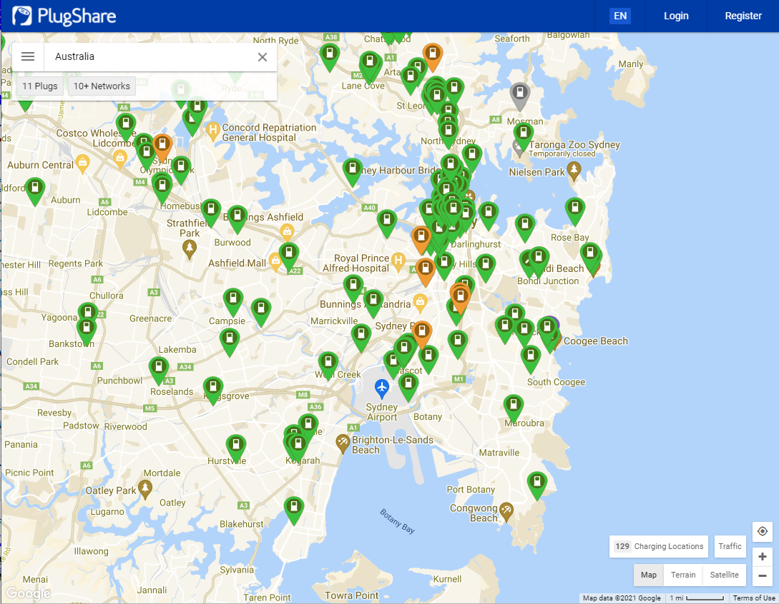
Plugshare

Slide 25
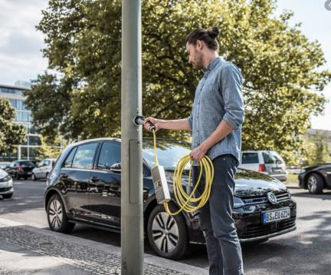
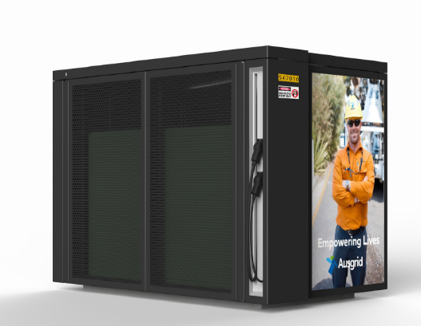
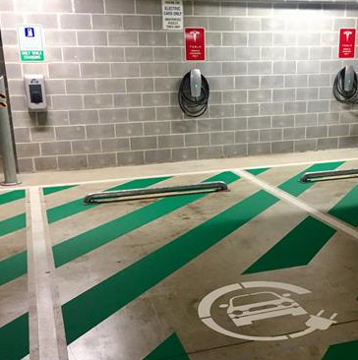
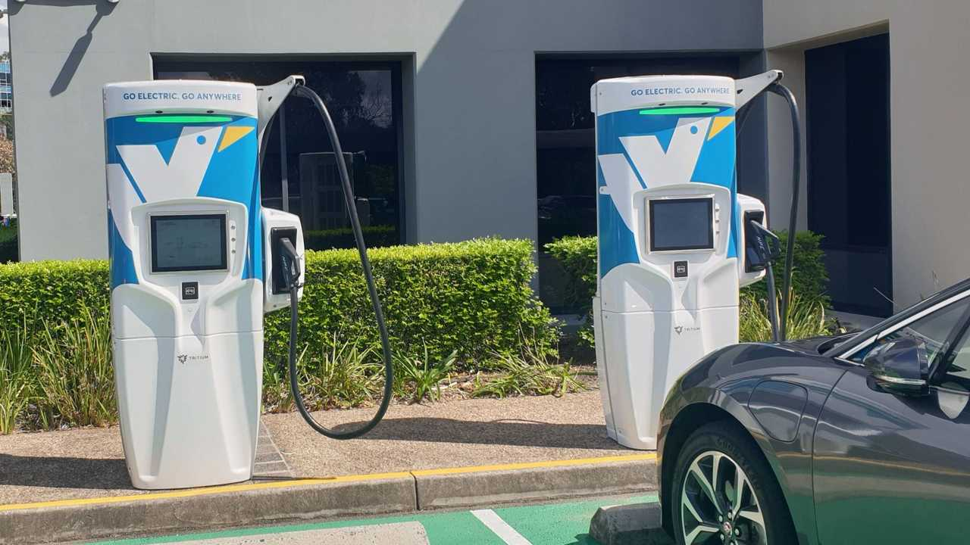
What's Next?

Slide 26
Resources
The Driven
NRMA – Electric Vehicles
Electric vehicle charging in Apartments (webinar)
Total cost of ownership of an EV
Electric Vehicle Council
AEVA
EV Battery recycling

Slide 27
Case Study

Slide 28
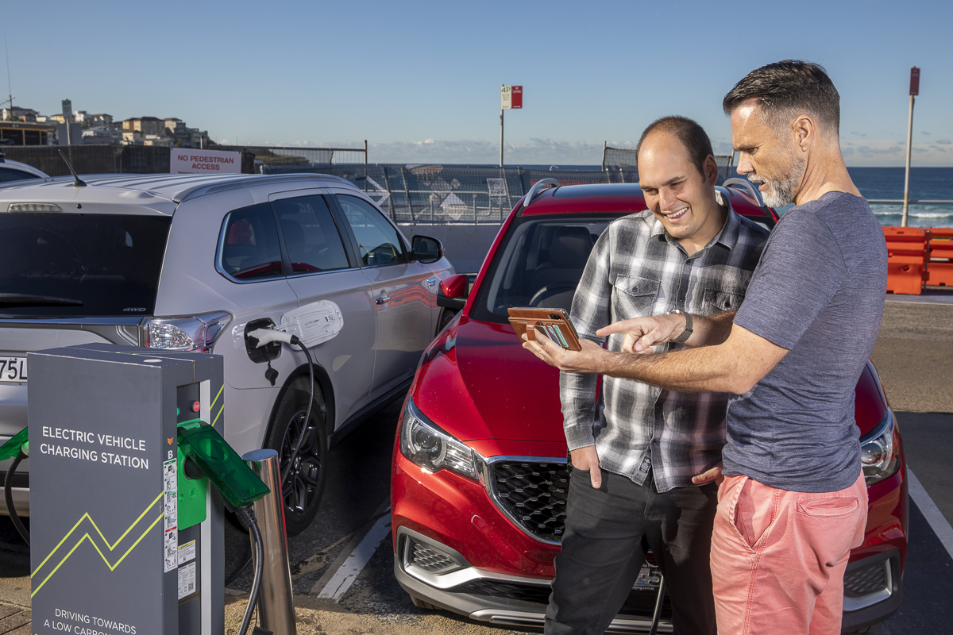
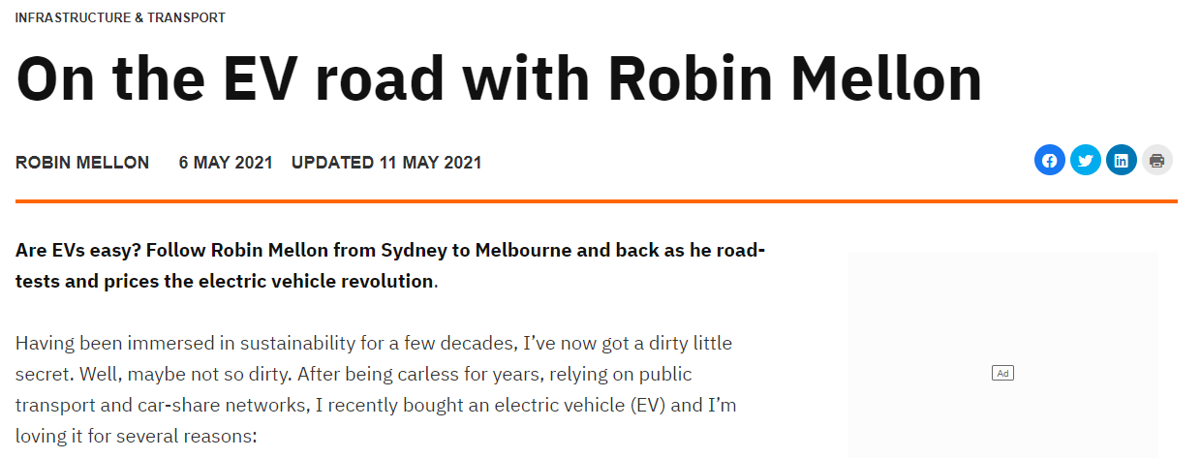
Robin Mellon
CEO, Better Sydney
W: www.bettersydney.com.au T: @bettersydney

Slide 29
Questions
So which EV do you have, and why did you buy it?
Where do you usually charge it?
How far do you usually drive it, and what's the furthest you've taken it?
Do you ever get 'range anxiety' - worrying you'll not have enough charge to get there?
How long does it usually take to charge up?
What differences have you noticed in costs so far?
What are the biggest three differences you've noticed since buying an EV?

Slide 30
Council Programs

Slide 31
Local EV Initiatives
All
Increasing the number of EV charging stations – including fast DC charging and supporting residents without offstreet parking
Fleet transition to EVs
Randwick:
Rebates for EV Charger installations. Visit Sustainability Rebates
Waverley:
Provisions in DCP for charging stations in new multi-dwelling housing
Educate on the provision of charging stations at apartment buildings
Woollahra:
Provisions in DCP for charging stations in new multi-dwelling housing
See Council's website for more information

Slide 32
Questions

